Slide 1
Civil Legal Aid in NV
New Commission Member Orientation
Brad Lewis
Director
Nevada Supreme Court
Access to Justice Commission

Slide 2
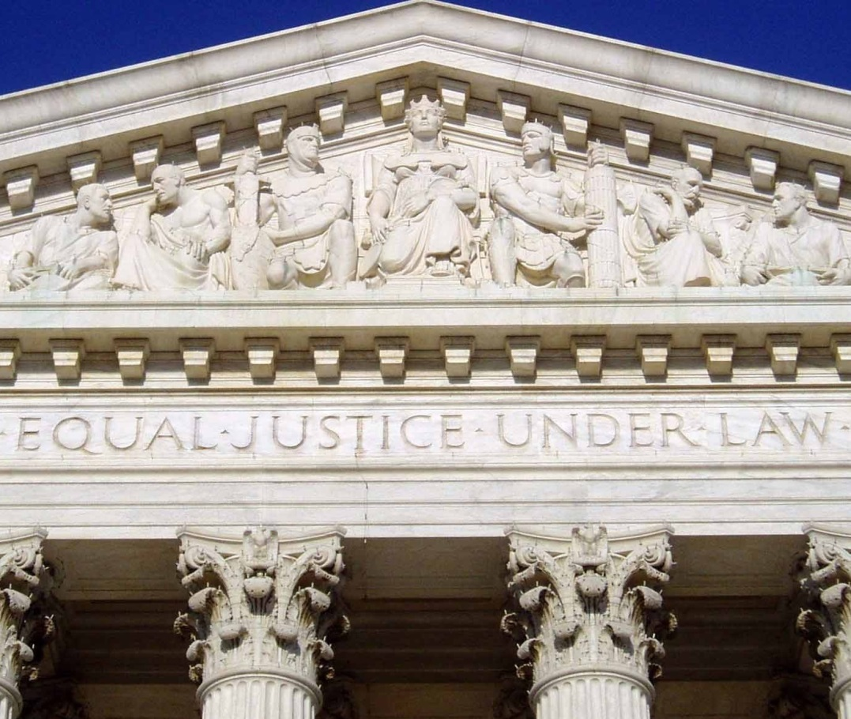
An American Promise
Equal Justice Under Law

Slide 3
And a Question
Who is more likely to win in court:
A.) A person who represents themselves?
B.) A person who is represented by a lawyer?

Slide 4
What is the Access to Justice Commission?
Mission
The Access to Justice Commission works with Nevada’s legal aid providers to improve access to civil justice for people of limited means in Nevada
What we do
Assess needs
Develop policies
Improve self-help and pro bono
Increase awareness
Pursue funding
Recommend rules and legislation

Slide 5
Nevada’s Five Core Legal Aid Providers

Slide 6
Who are our clients?
Nearly 1 million (990,000) Nevadans are eligible for legal aid (based on 200% of the federal poverty level).

Slide 7
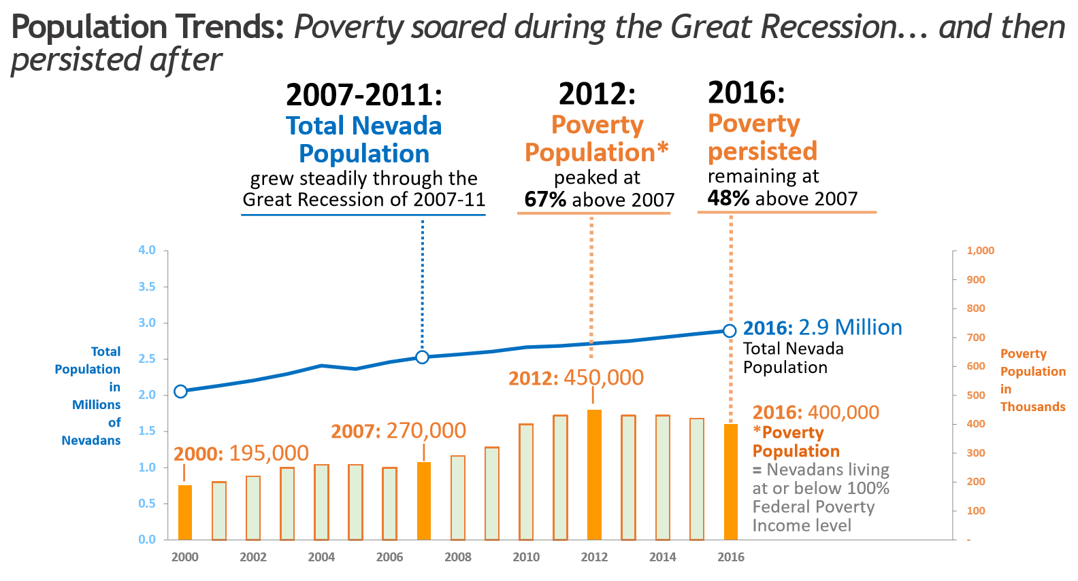
What is the Poverty Landscape in Nevada?

Slide 8
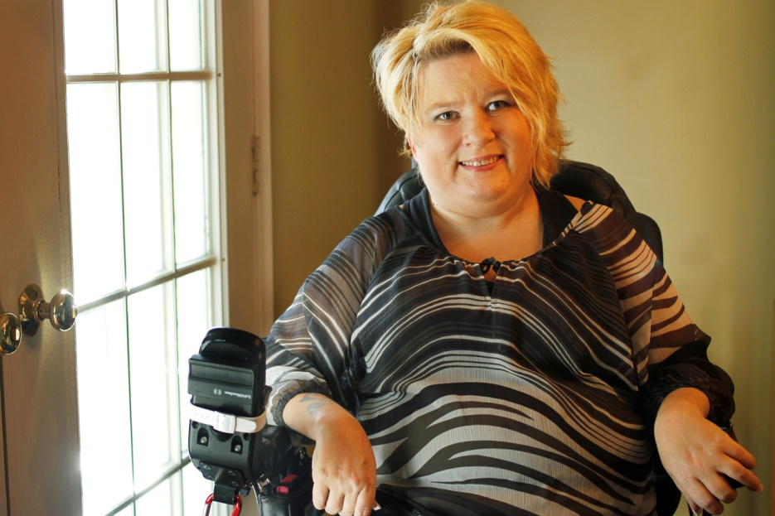
Who are our clients?
Vulnerable populations served
People with disabilities
Seniors 60+
Children
Homeless
Domestic violence
and sexual assault victims

Slide 9
Who are our clients?
Populations served
Veterans and military families
Families with children
Native Americans
Immigrants
Inmates
Victims of Violence
Persons living with HIV/AIDS

Slide 10
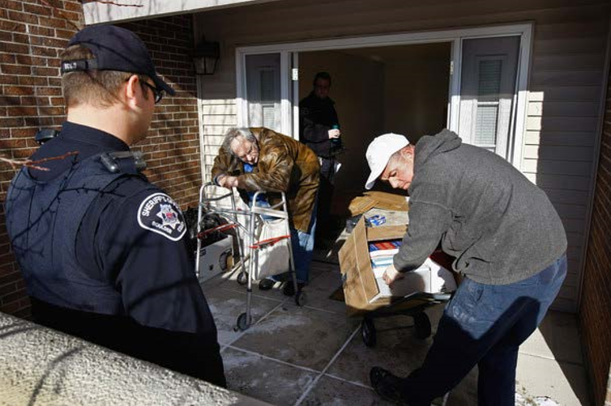
What do we do?
Provide legal representation to those with limited means*
Legal advice
Brief or limited legal services
Negotiation
Litigation
Appeals
Advocacy targeted to address systemic issues for our clients
*Nevada ranks 29th out of 50
states in poverty.

Slide 11
What do we do?
Offer other services
Community education, clinics and “Ask-A-Lawyer” events
Volunteer (pro bono) attorney recruitment, training, mentoring, and management
Public policy advocacy
Investigation and monitoring
Communications

Slide 12
How do clients apply for services?
Office walk-ins
Self-Help Centers
Online applications
By phone
By mail
Referrals

Slide 13
Who gets help? And the “Justice Gap”
Need: Each year 147,000 legal problems are experienced each year by low income Nevadans
Capacity: In 2016, 35,000 cases were closed by Nevada’s five core legal aid providers.
The “Justice Gap”: 112,000
76% of all legal needs go unmet.

Slide 14
What types of cases do we handle?
Income & Employment
Health
Consumer
Family, Juvenile & Education
Housing
Immigration
And more…

Slide 15
Who provides the services?
Nevada’s Five Core Legal Aid Providers
214 staff located across Nevada including:
84 lawyers
28 paralegals
102 other staff
1 legal aid attorney for every 6,000 eligible clients
How does this compare to attorneys available for a fee?
1 private attorney for every 400 people

Slide 16
What challenges does legal aid face?
Low salaries/recruitment/competitive market
High case loads
Limited litigation budgets
Lean support staff
Fundraising
Funding restrictions
Reporting requirements by funders
Clients’ personal limitations

Slide 17
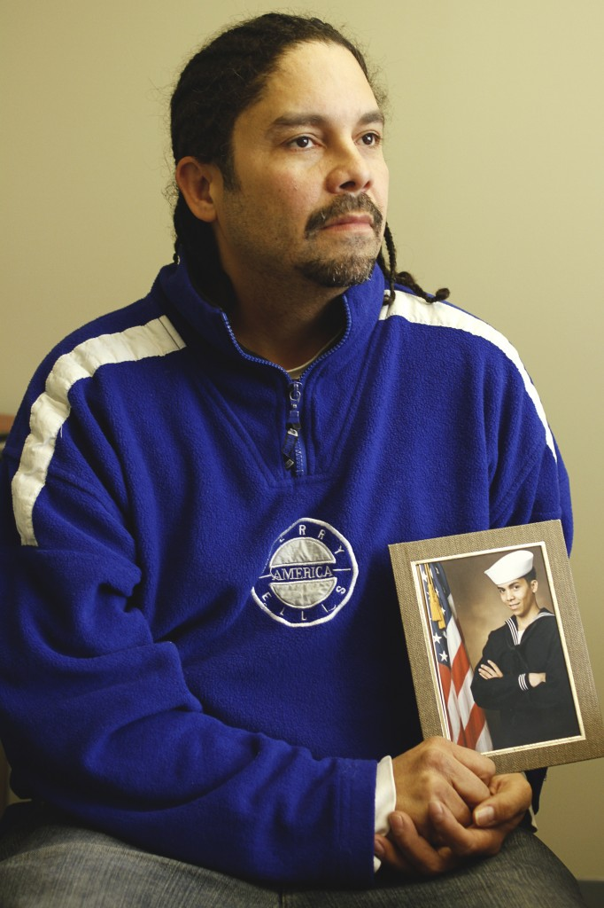
How many clients do we represent annually?
Closed 35,000+ cases in 2016
Touch thousands of additional clients each year through legal clinics, Ask-A-Lawyer, events, and more

Slide 18
How are we funded?
Filing fees
Federal, state, and local governments
IOLTA
Private and public foundations, including bar organizations
Individual donations
Events
Dues Check-Off
Other

Slide 19
Who benefits from legal aid?
Clients and their families
Judges and Courts in all counties
All communities across Nevada
Anyone needing a court remedy
by speeding proceedings
and avoiding delays caused
by un-represented clients

Slide 20
What are the economic benefits of legal aid?
$24.8 million in new federal benefits, including food stamps, SSI, disability and federal tax refunds
$8.3 million in Medicare and Medicaid reimbursements
$4.6 million in veterans benefits.
$2.2 million in child support

Slide 21
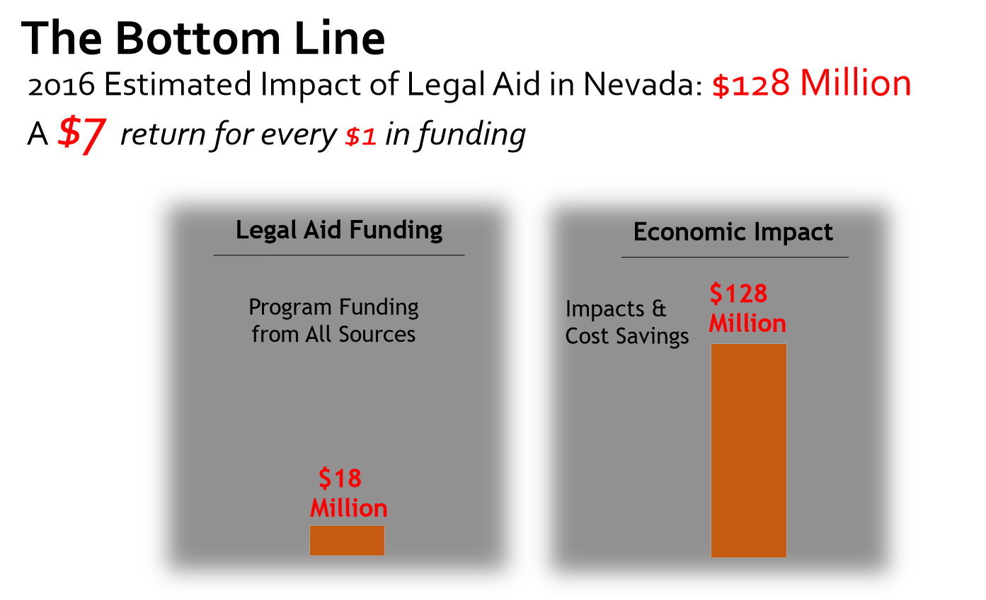
What are the economic benefits of legal aid?

Slide 22
Challenges clients face to get a legal aid lawyer
Knowledge – identification of legal problem and where to go for assistance
Personal limitations
Geography
Eligibility for services
Case type
Staffing

Slide 23
Benefits of Legal Aid

Slide 24
Benefits of Legal Aid

Slide 25
Benefits of Legal Aid

Slide 26
Your Role as a Commission Member
Attend Meetings 3x/Year
Participate on a Committee(s), as agreed
Dedicate a Reasonable Amount of Time
Act as an Advocate
Stay Informed

Slide 27
Thank You and Questions

Slide 28
Only if Time…
Story on next slides 29-35

Slide 29
Meet Nancy
Single mother with daughter
Worked as a customer service representative
Suffered a stroke and slipped into a coma
Hospitalized and in a coma for 3 days
Fired from her job for missing 3 days of work without calling to report an absence
Asked employer for job back but employer said “no”
Cannot pay rent, food, utilities, gas for her car, etc.
Filed for unemployment benefits
Denied unemployment benefits

Slide 30
What does Nancy do?
Nancy needs a lawyer to handle this complex legal matter. How does she find one? The first hurdle: knowledge Decision denying benefits includes a pamphlet with information about legal services
Nancy calls toll-free number on pamphlet

Slide 31
What does Nancy do?
The second hurdle: Personal Limitations
No transportation
Difficulty remembering details after stroke
Doesn’t know how to appeal denial and the 10-day deadline to do so
Providing copies of her unemployment paperwork to lawyer
Nancy talks to legal aid lawyer; legal aid lawyer sends her follow up letter and envelope with address and postage to send paperwork

Slide 32
Does Nancy qualify for services?
Next hurdle: Eligibility for services
Does she meet income and asset eligibility?
Does the household income including wages and child support exceed $19,913 pre tax (125% of poverty guidelines for two-person household)?
Good news! Nancy qualifies to receive services.

Slide 33
Is Nancy’s case one that legal aid will handle?
Next hurdle: Case type
Legal aid providers handle different types of cases.
Has Nancy contacted a legal aid provider that will handle her particular case type?
Yes, her local legal aid office handles this type of case.

Slide 34
Will Nancy get a lawyer?
Final hurdle: Staffing limitations
Does her local legal aid office have a staff attorney to take her case?
The legal aid office has an attorney who can represent Nancy to appeal the denial of her unemployment benefits.

Slide 35
How does Nancy’s story end?
Legal aid agreed to represent Nancy to appeal the decision denying her unemployment benefits.
Without her job and without unemployment benefits, Nancy could not pay her rent.
Nancy and her daughter were evicted before her case was heard.
Nancy won her appeal and got unemployment benefits. She used the benefits to get another apartment.

Slide 36
